Slide 1
Chapter Three Multiple Activities, Passing Data between Activities, Transitions, Persistent Data

Slide 2
Learning Objectives
Build an app involving several activities
Manage the life cycle of an activity
Use a RelativeLayout and a TableLayout
Handle persistent data
Animate the transition between screens

Slide 3
Mortgage App
More Model-View-Controller
Two Screens ➔ Two Activities
RelativeLayout, TableLayout
Go back and forth between the two Activities
Pass data between Activities
Handle persistent data
Animated transition between screens

Slide 4
Mortgage—the Model
The Mortgage class encapsulates a mortgage (see next slide).
Amount, interest rate, number of years
Methods to calculate the monthly payment, the total payments

Slide 5
import java.text.DecimalFormat;
public class Mortgage {
public final DecimalFormat MONEY
= new DecimalFormat( "$#,##0.00" );
private float amount;
private int years;
private float rate;
public Mortgage( ) {
setAmount( 100000.0f );
setYears( 30 );
setRate( 0.035f ); }
public void setAmount( float newAmount ) {
if( newAmount >= 0 )
amount = newAmount; }
public void setYears( int newYears ) {
if( newYears >= 0 )
years = newYears; }
public void setRate( float newRate ) {
if( newRate >= 0 )
rate = newRate; }
public float getAmount( ) {
return amount; }
public String getFormattedAmount( ) {
return MONEY.format( amount );
}
public int getYears( ) {
return years;
}
public float getRate( ) {
return rate;
}

Slide 6
public float monthlyPayment( ) {
float mRate = rate / 12; // monthly interest rate
double temp = Math.pow( 1/( 1 + mRate ), years * 12 );
return amount * mRate / ( float ) ( 1 - temp );
}
public String formattedMonthlyPayment( ) {
return MONEY.format( monthlyPayment( ) );
}
public float totalPayment( ) {
return monthlyPayment( ) * years * 12;
}
public String formattedTotalPayment( ) {
return MONEY.format( totalPayment( ) );
}
}

Slide 7
Two Screens
Screen 1: summary, monthly payment, total payment
Screen 2: user input for amount, interest rate, number of years
When going from screen 2 to screen 1, we update the data in screen 1.

Slide 8
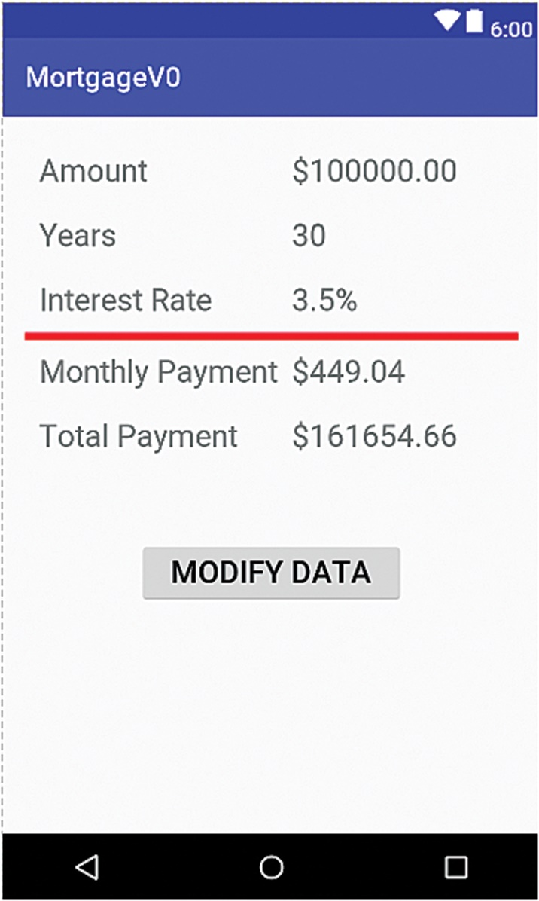
Screen 1

Slide 9
TableLayout (1 of 8)
We use a TableLayout for screen 1.
TableLayout is a subclass of LinearLayout, itself a subclass of ViewGroup.
A TableLayout arranges its children in rows and columns.

Slide 10
TableLayout (2 of 8)
6 rows, 2 columns
First 5 rows: two TextViews: label and data
Last row: button (to go to second activity/screen)

Slide 11
TableLayout (3 of 8)
Typically uses a TableRow to define a row
Inside a TableRow, we place two TextViews for the first 5 rows.
We separate the first 3 rows (user input data) from the next 2 rows (calculated data) with a red line.

Slide 12
TableLayout (4 of 8)
<TableRow
android:layout_width="wrap_content" android:layout_height="wrap_content" >
<TextView
android:text="@string/label_amount"
android:padding="10dip" /> <TextView
android:id="@+id/amount"
android:text="@string/amount" />
</TableRow>

Slide 13
TableLayout (5 of 8)
We use strings defined in strings.xml as needed.
We give ids to elements as needed.

Slide 14
TableLayout (6 of 8)
<!-- red line -->
<View
android:layout_height="5dip" android:background="#FF0000" />

Slide 15
TableLayout (7 of 8)
The last row is just one Button.
We center it within the row.
When the user clicks on the button, the modifyData method executes.

Slide 16
TableLayout (8 of 8)
<TableRow
android:layout_width="wrap_content" android:layout_height="wrap_content" android:gravity="center" android:paddingTop="50dip" > <Button
android:text="@string/modify_data"
android:onClick="modifyData" />
</TableRow>

Slide 17
strings.xml
In Version 0, we hard code values in the strings.xml file.
We do not use the Model. We fill the TextViews with those hard coded values.

Slide 18
styles.xml
We edit styles.xml, defining a text size.
<item name = "android:textSize">42dp
</item>

Slide 19
Screen 2 (1 of 3)
Screen 2 is for user input.
When the user clicks on the button of screen 1, we go to screen 2.
We use a RelativeLayout.

Slide 20
Screen 2 (2 of 3)
Number of years ➔ Three radio buttons (10, 15, 30 years)
Mortgage amount ➔ EditText
Interest rate ➔ EditText

Slide 21
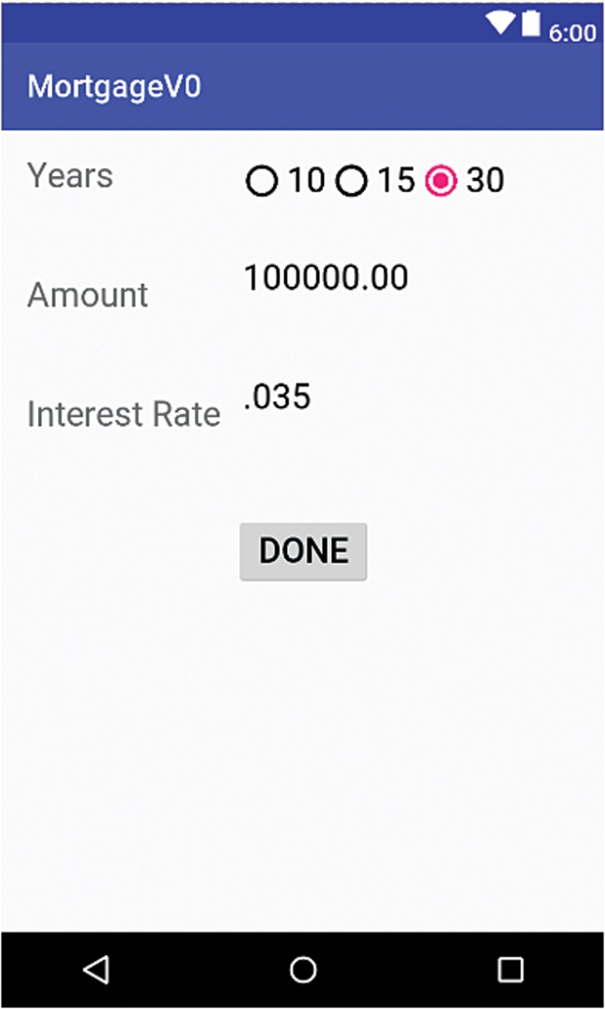
Screen 2 (3 of 3)

Slide 22
Radio Buttons
RadioButton class/XML element
Each RadioButton element is placed inside a RadioGroup element ➔ they are mutually exclusive.

Slide 23
RadioGroup
<RadioGroup android:layout_toRightOf="@+id/label_years" android:layout_width="match_parent" android:layout_height="wrap_content" android:layout_alignLeft="@+id/data_rate" android:orientation="horizontal">

Slide 24
RadioButton
<RadioButton android:layout_width="wrap_content" android:layout_height="wrap_content" android:id="@+id/ten" android:text="@string/ten" />

Slide 25
strings.xml
We add strings to strings.xml for the elements in the second screen
...
<string name="thirty">30
</string>
<string name="amountDecimal">100000.00
</string>
...

Slide 26
Testing Screen 2
We can look at screen 2 in the preview
OR
We can change the View resource in MainActivity and run the app
// setContentView( R.layout.activity_main );
setContentView( R.layout.activity_data );

Slide 27
Connecting the Two Activities (1 of 2)
In Version 1, we add code to MainActivity to go to the second activity and also come back to the first activity.
We create a class for the second activity, DataActivity.
We edit AndroidManifest.xml to include a second activity element.

Slide 28
Connecting the Two Activities (2 of 2)
Activities are organized on a stack.
What the user sees is the View of the Activity at the top of the stack.
We go to another activity ➔ that activity is placed at the top of the stack.
We finish an activity ➔ that activity is popped off the stack.

Slide 29
Activity Class Methods
public void startActivity( Intent intent ) Launches a new activity using intent as the Intent to start it.
public void finish( ) Closes this activity and pops it off the stack; the screen for the prior activity is shown.

Slide 30
Intent
Intent Constructor
Intent( Context context, Class<?> cls ) Constructs an Intent that is intended to execute a class modeled by type ? (probably some Activity class) that is in the same application package as context

Slide 31
From Screen 1 to Screen 2 (1 of 2)
Inside modifyData of MainActivity
Create an Intent to go to a DataActivity
Execute that Intent and start that DataActivity

Slide 32
From Screen 1 to Screen 2 (2 of 2)
public void modify( View v ) {
Intent intent = new Intent( this,
DataActivity.class );
this.startActivity( intent );
}

Slide 33
Back to Screen 1 From Screen 2 (1 of 2)
Finish current activity (this DataActivity)
➔ That pops it off the stack.
➔ The View for previous activity (MainActivity) the shows

Slide 34
Back to Screen 1 From Screen 2 (2 of 2)
Inside DataActivity.
public void goBack( View v ) {
this.finish( );
}

Slide 35
AndroidManifest.xml (1 of 2)
Add an activity element for the second activity (DataActivity)
Place it inside the application element (like the first activity element)

Slide 36
AndroidManifest.xml (2 of 2)
<application …>
<activity android:name=".MainActivity" …
</activity>
<activity
android:name=".DataActivity"
android:label="@string/app_name" >
</activity>

Slide 37
Run the App
Now we can go back and forth between the two screens.
From screen 1 to screen 2, we push a DataActivity onto the activity stack.
From screen 2 to screen 1, we pop it off the stack.

Slide 38
Life Cycle of an Activity
An activity has a life.
Some of its methods are called automatically (onCreate among others).
... When the activity goes in the background, comes back to the foreground, is finished ...

Slide 39
Life Cycle Methods of Activity (1 of 4)
onCreate, onStart, onResume, onPause, onStop, onRestart, onDestroy are the life cycle methods of the Activity class.

Slide 40
Life Cycle Methods of Activity (2 of 4)
onCreate: called when the activity is first created
onStart: called after onCreate, when the activity becomes visible
onResume: called after onResume, when the user starts interacting with the activity

Slide 41
Life Cycle Methods of Activity (3 of 4)
onPause: called when Android starts or resumes another activity
onStop: called when the activity becomes invisible to the user
onRestart: called when the activity is about to restart
onDestroy: called when the activity has ended

Slide 42
Life Cycle Methods of Activity (4 of 4)
We can place Log statements inside each of these methods inside both Activity classes and check the Logcat output.
We use a device, go back and forth between the two activities, let the current activity go in the background, then hit the Power button and swipe the screen to bring it to the foreground ...

Slide 43
Sharing Data between Activities (1 of 8)
In Version 2, when we come back from screen 2 to screen 1, we update screen 1.
We do the same when we go from screen 1 to screen 2.
We pass data from screen 2 to screen 1 but also from screen 1 to screen 2.
There are many ways of doing that.

Slide 44
Sharing Data between Activities (2 of 8)
Use the putExtra methods of the Intent class.
We can only pass primitive data types or Strings.
➔ not very convenient here because we want to pass the whole Mortgage object.

Slide 45
Sharing Data between Activities (3 of 8)
An easy way to pass (or more exactly share) data between the two activities is to declare the Mortgage instance variable public and static in the MainActivity class.
public static Mortgage mortgage;
➔ we can access it inside the DataActivity class using MainActivity.mortgage.

Slide 46
Sharing Data between Activities (4 of 8)
We could also rewrite the Mortgage class as a singleton class.
➔ in this way, only one object of that class can be instantiated.
➔ it is automatically shared among the various activities.

Slide 47
Sharing Data between Activities (5 of 8)
Use a file or a sqllite database to store the data.
Read and write as needed.
➔ Either way, that is an overkill for this app.

Slide 48
Sharing Data between Activities (6 of 8)
For this app, the simplest way to share data among activities is to make the mortgage instance variable public and static.
Note: we will look at the putExtra method later in other examples.

Slide 49
Sharing Data between Activities (7 of 8)
In MainActivity, we add the updateView method to update the various TextViews based on data in the Model (mortgage instance variable).
Call updateView inside onStart

Slide 50
Sharing Data between Activities (8 of 8)
In DataActivity, add an updateView and an updateMortgageObject methods to:
Update the various GUI elements
Update the Model data after user input

Slide 51
Updating the GUI in Screen 1 (1 of 4)
Use the findViewById method to retrieve a TextView.
Update the text inside the TextView with data retrieved from the Model.

Slide 52
Updating the GUI in Screen 1 (2 of 4)
public void updateView( ) { // retrieve all the TextViews
// update all the TextViews
// based on the data inside the Model
}

Slide 53
Updating the GUI in Screen 1 (3 of 4)
public void updateView( ) { TextView amountTV = findViewById( R.id.amount ); amountTV.setText( mortgage.getFormattedAmount( ) ); TextView yearsTV = findViewById( R.id.years ); yearsTV.setText( "" + mortgage.getYears( ) );
…
}

Slide 54
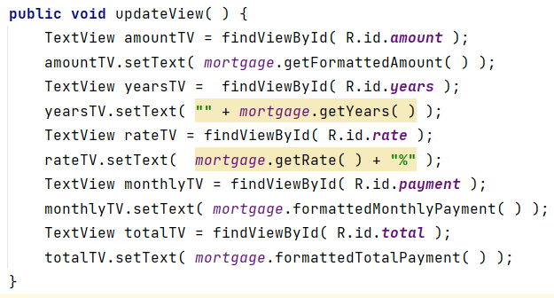
© Dr. Modafar Ati

Slide 55
Updating the GUI in Screen 1 (4 of 4)
Call updateView every time the View shows.
public void onStart( ) { super.onStart( ); updateView( );
}

Slide 56
Updating the GUI in Screen 2 (1 of 8)
Same as for screen 1
Use the findViewById method to retrieve a TextView or a RadioButton
Update the text inside the TextView with data retrieved from the Model
Check the radio button depending on state of Model

Slide 57
Updating the GUI in Screen 2 (2 of 8)
public void updateView( ) {
// Get a reference to our Mortgage object Mortgage mortgage =MainActivity.mortgage;
// update the View }

Slide 58
Updating the GUI in Screen 2 (3 of 8)
// update the radio buttons
if( mortgage.getYears( ) == 10 ) { RadioButton rb10 = findViewById( R.id.ten ); rb10.setChecked( true ); } else if( mortgage.getYears( ) == 15 ) { RadioButton rb15 = findViewById( R.id.fifteen ); rb15.setChecked( true ); } // else do nothing (default is 30)

Slide 59
Updating the GUI in Screen 2 (4 of 8)
// update the EditTexts
EditText amountET = findViewById( R.id.data_amount ); amountET.setText( "" + mortgage.getAmount( ) ); EditText rateET = findViewById( R.id.data_rate );
rateET.setText( "" + mortgage.getRate( ) );

Slide 60
Updating the GUI in Screen 2 (5 of 8)
Access the Mortgage object using MainActivity.mortgage
Access the GUI elements using the findViewById method
Retrieve user input
Convert user input (a String) to a float as necessary
Use the mutators of the Mortgage class to change the data inside the Mortgage object

Slide 61
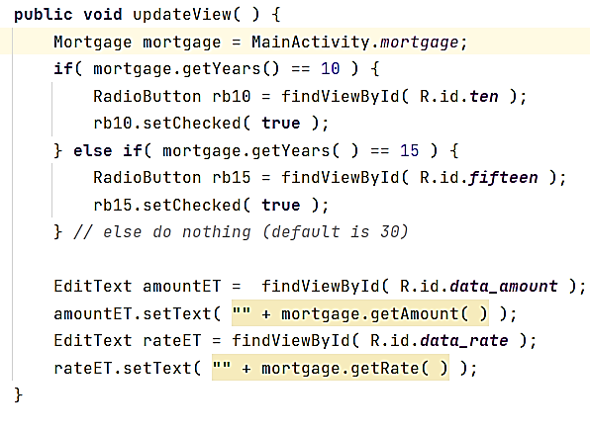
© Dr. Modafar Ati

Slide 62
Updating the GUI in Screen 2 (6 of 8)
public void updateMortgageObject( ) { Mortgage mortgage = MainActivity.mortgage;
// update years in Model
RadioButton rb10 = findViewById( R.id.ten ); RadioButton rb15 = findViewById( R.id.fifteen ); int years = 30; if( rb10.isChecked( ) ) years = 10; else if( rb15.isChecked( ) ) years = 15; mortgage.setYears( years ); …
}

Slide 63
Updating the GUI in Screen 2 (7 of 8)
// update data amount in Model
EditText amountET = findViewById( R.id.data_amount ); String amountString = amountET.getText( ).toString( ); ...
try { float amount = Float.parseFloat( amountString );
mortgage.setAmount( amount );
…
} catch( NumberFormatException nfe ) { mortgage.setAmount( 100000.0f ); …
}

Slide 64
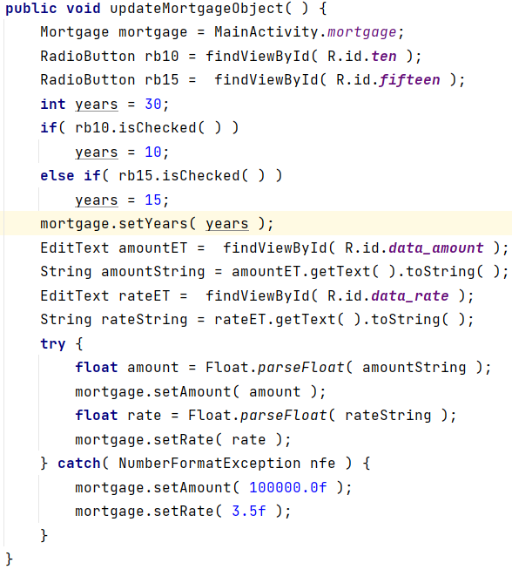
© Dr. Modafar Ati

Slide 65
Updating the GUI in Screen 2 (8 of 8)
We update the state of the Model before we go back to activity 1.
public void goBack( View v ) { updateMortgageObject( ); this.finish( ); }

Slide 66
Transitions/Animations
In Version 3, we enhance the user experience by setting up transitions between screens.
Fade, scale, move left to right …
Frame by frame or tween (automatically defined between a start frame and an end frame).

Slide 67
Animations
XML | Class | Description
set | AnimationSet | A set of several animations
alpha | AlphaAnimation | Fade in or out
Rotate | RotateAnimation | Rotate around a fixed point
scale | ScaleAnimation | Scale from a fixed point
translate | TranslateAnimation | Sliding animation

Slide 68
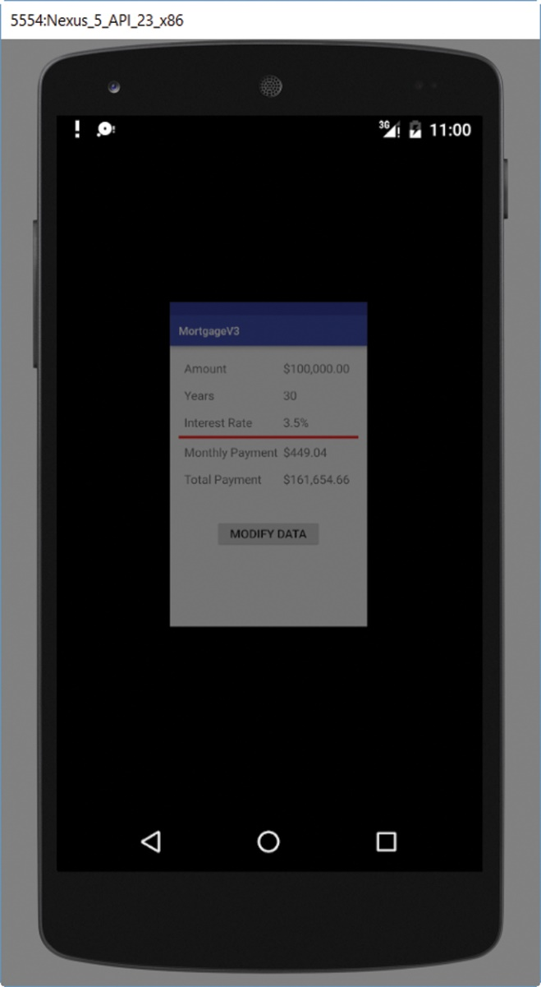
Transitions/Animations (1 of 2)
We can use either XML or code to define animations.
We use XML.

Slide 69
Transitions/Animations (2 of 2)
Create a directory (anim) inside the res directory.
Define animations in XML (one animation per XML file).
Each XML element has attributes to define the animation.

Slide 70
slide_from_left.xml (1 of 2)
Translation: main parameters are:
From position, to position, duration.
<translate android:fromXDelta="-100%p" android:toXDelta="0" android:duration="4000" />

Slide 71
slide_from_left.xml (2 of 2)
<?xml version="1.0" encoding="utf-8"?>
<set xmlns:android=
"http://schemas.android.com/apk/res/android" android:interpolator=
"@android:anim/accelerate_interpolator" > <translate android:fromXDelta="-100%p" android:toXDelta="0" android:duration="4000" />
</set>

Slide 72
fade_in_and_scale.xml (1 of 2)
Can define several animations that will run concurrently
We place them inside a set element.
First, we define a fade animation.
We follow it with a scale animation.

Slide 73
fade_in_and_scale.xml (2 of 2)
Translation: main parameters
From position, to position, duration
<set … > <alpha android:fromAlpha="0.0" android:toAlpha="1.0" android:duration="3000" /> <scale
android:fromXScale="0.0"
android:toXScale="1.0"
… />
</set>

Slide 74
Specifying a Transition
Now that we have defined animations, we can use them in order to transition from screen 1 to screen 2 and back from screen 2 to screen 1.

Slide 75
overridePendingTransition (1 of 2)
Two animation resources are specified.
One to enter the new activity and one to exit the current activity.

Slide 76
overridePendingTransition (2 of 2)
We use this method from the Activity class to specify a transition from one activity to another.
void overridePendingTransition ( int enterAnimResource, int exitAnimResource )

Slide 77
Inside MainActivity
public void modifyData( View v ) { Intent myIntent = new Intent( this,
DataActivity.class ); this.startActivity( myIntent ); overridePendingTransition(
R.anim.slide_from_left, 0 );
/* 0 ➔ no animation is used to transition from screen 1 */
}

Slide 78
Inside DataActivity
public void goBack( View v ) { updateMortgageObject( ); this.finish( );
overridePendingTransition(
R.anim.fade_in_and_scale, 0 );
}

Slide 79
Managing Persistent Data (1 of 5)
Next time we use the app, we want the app to remember the last mortgage data and use that data on the first and second screens.
➔ that data is persistent.
In Version 4, we make the data persistent.

Slide 80
Managing Persistent Data (2 of 5)
When the user uses the app for the first time, we show the default values for the three mortgage parameters: the mortgage amount, the interest rate, and the number of years.
But when the user uses the app again, we want to show the values that were used the last time the user used the app.

Slide 81
Managing Persistent Data (3 of 5)
In order to implement that functionality, we write to a file on the device the mortgage parameters every time they are changed.
When we start the app the first time, the file does not exist and we use the default parameters for the mortgage. When we run the app afterwards, we read the mortgage parameters from the file.

Slide 82
Managing Persistent Data (4 of 5)
Although we could use the openFileOutput and openFileInput methods of the ContextWrapper class to open a file for writing and reading, it is easier to use the user preferences system in order to store and retrieve persistent data.

Slide 83
Managing Persistent Data (5 of 5)
Preferences for an app are organized as a set of key/value pairs, like a hashtable.
In this app, since we have three values for a mortgage, we have three key/value pairs.

Slide 84
SharedPreferences
The SharedPreferences interface includes the functionality to write to and read from the user preferences.
Its static inner interface, Editor, enables us to store user preferences.

Slide 85
SharedPreferences.Editor
We can use the putDataType methods of SharedPreferences.Editor to store data on the device. They have this general method header:
public SharedPreferences.Editor putDataType( String key, DataType value )

Slide 86
Method | Description
SharedPreferences.Editor putInt( String key, int value) | Associates value with key in this SharedPreferences.Editor. These key/value pairs should be committed by calling either the commit or apply method. Returns this SharedPreferences.Editor so that method calls can be chained.
SharedPreferences.Editor putFloat( String key, float value) | Associates value with key in this SharedPreferences.Editor. These key/value pairs should be committed by calling either the commit or apply method. Returns this SharedPreferences.Editor so that method calls can be chained.

Slide 87
SharedPreferences.Editor (1 of 2)
Assuming we have a SharedPreferences.Editor reference named editor, in order to associate the value 10 with the key rating, we write:
// editor is a SharedPreferences.Editor editor.putInt( "rating", 10 );

Slide 88
SharedPreferences.Editor (2 of 2)
In order to actually write to the user preferences, we need to call the commit or apply method.
// editor is a SharedPreferences.Editor editor.putInt( "rating", 10 );
editor.commit( );

Slide 89
SharedPreferences (1 of 5)
To retrieve data previously written to the user preferences, we use the getDataType methods of the SharedPreferences interface.
The getDataType methods have this general method header:
public DataType getDataType( String key,
DataType defaultValue )

Slide 90
SharedPreferences (2 of 5)
Method | Description
int getInt( String key, int defaultValue) | Returns the int value associated with key in this SharedPreferences object; returns defaultValue if the key is not found.
float getFloat( String key, float defaultValue ) | Returns the float value associated with key in this SharedPreferences object; returns defaultValue if the key is not found.

Slide 91
SharedPreferences (3 of 5)
Assuming we have a SharedPreferences reference named pref, in order to retrieve the value that was previously associated with the key rating and written to the preferences, we write:
// pref is a SharedPreferences
// default value is 1 int storedRating = pref.getInt( "rating", 1 );

Slide 92
SharedPreferences (4 of 5)
We can use the getDefaultSharedPreferences static method of the PreferenceManager class in order to get a SharedPreferences reference.
Method | Description
static SharedPreferences getDefaultSharedPreferences( Context context ) | Returns the SharedPreferences for context.

Slide 93
SharedPreferences (5 of 5)
Since the Activity class inherits from Context and our MainActivity and DataActivity classes inherit from Activity, we can pass the keyword this as the argument of this method.
Thus, inside an Activity class, in order to get a SharedReferences inside our two classes, we can write:
SharedPreferences pref = ReferenceManager.getDefaultSharedPreferences( this );

Slide 94
SharedPreferences.Editor
Once we have a SharedReferences reference, we can call the edit method of SharedPreferences to obtain a Sharedpreferences.Editor reference:
SharedPreferences pref = ReferenceManager
.getDefaultSharedPreferences( this );
SharedPreferences.Editor editor = pref.edit( );

Slide 95
Impact on Our Classes (1 of 2)
The View components of our app are still the same.
Most of the changes take place in the Model, the Mortgage class.
We also have small changes in the Controller classes, MainActivity and DataActivity.

Slide 96
Impact on Our Classes (2 of 2)
We modify the Mortgage class so that it includes a method to write mortgage data to the user preferences system and a constructor to read data from it.
In both the MainActivity and DataActivity classes, we use these methods to either load or write the mortgage parameters from and to the user preferences system.

Slide 97
Mortgage Class (1 of 2)
Inside the constructor, we read the preferences and assign the corresponding values to the three instance variables: amount, rate, and years.
If it is the first time the app is run, there are no preferences set; we assign default values to the three instance variables.

Slide 98
Mortgage Class (2 of 2)
Since we need three keys (for three values that we store in the preferences), we define three constants for them:
private static final String PREFERENCE_AMOUNT
= "amount";
private static final String PREFERENCE_YEARS
= "years"; private static final String PREFERENCE_RATE
= "rate";

Slide 99
Mortgage Constructor
public Mortgage( Context context ) { SharedPreferences pref = PreferenceManager
.getDefaultSharedPreferences( context );
setAmount( pref.getFloat( PREFERENCE_AMOUNT,
100000.0f ) ); setYears( pref.getInt( PREFERENCE_YEARS, 30 ) ); setRate ( pref.getFloat( PREFERENCE_RATE, 0.035f ) ); }

Slide 100
Mortgage Class (1 of 2)
We include the method setPreferences: it writes to the preferences.
We include a Context parameter so we can pass it to the getDefaultSharedPreferences method.
public void setPreferences( Context context )

Slide 101
Mortgage Class (2 of 2)
When we call the setPreferences method from the DataActivity class using the Mortgage object reference mortgage, we will pass this.
mortgage.setPreferences( this );

Slide 102
setPreferences Method (1 of 3)
public void setPreferences( Context context ) { // Get a SharedPreferences.Editor
// With it, write the data to the preferences
}

Slide 103
setPreferences Method (2 of 3)
First we get a SharedPreferences.Editor reference.
SharedPreferences pref = PreferenceManager.getDefaultSharedPreferences( context );
SharedPreferences.Editor editor = pref.edit( );

Slide 104
setPreferences Method (3 of 3)
Next, we write the data into the preferences.
Amount, years, and rate are the three instance variables of the Mortgage class.
editor.putFloat( PREFERENCE_AMOUNT, amount ); editor.putInt( PREFERENCE_YEARS, years ); editor.putFloat( PREFERENCE_RATE, rate );
editor.commit( );

Slide 105
MainActivity—onCreate
Inside the onCreate of MainActivity, we instantiate the Mortgage instance variable with this statement (an Activity "is a" ContextWrapper):
mortgage = new Mortgage( this );

Slide 106
DataActivity—updateMortgageObject
Inside the updateMortgageObject method, after calling the mutators to update the Mortgage data, we call setPreferences so that we write the current Mortgage data to the preferences.
mortgage.setPreferences( this );

Slide 107
AndroidManifest.xml
We need to specify in the manifest that this app writes to the device file system
We add a uses-permission element inside the manifest element as follows:
<uses-permission android:name= "android.permission.WRITE_EXTERNAL_STORAGE" />

